Slide 1

Cyclistic Case Study
Ermias Molla
July 2022
Source
Divvy: Data License Agreement | Divvy Bikes
Data from June 2021-May 2022

Slide 2
Hi, I’m Ermias Molla
Contact me
Linkedin: https://www.linkedin.com/in/ermias-molla/
Github: https://github.com/Ermiasmolla
Email: MollaErmias@gmail.com

Slide 3
Background
Cyclistic launched in 2016 as a bike-share service. Since then, the program has grown to a fleet of 5,824 bicycles that are geotracked and locked into a network of 692 stations across Chicago. The bikes can be unlocked from one station and returned to any other station in the system anytime.
There are Members and Casual Riders. Cyclistic’s finance analysts have concluded that annual members are much more profitable than casual riders. Cyclistic’s believes that maximizing the number of annual members will be key to future growth.

Slide 4
Challenge: Design marketing strategies in order to convert casual riders into annual members
Identify the key differences in usage between members and casual riders

Slide 5
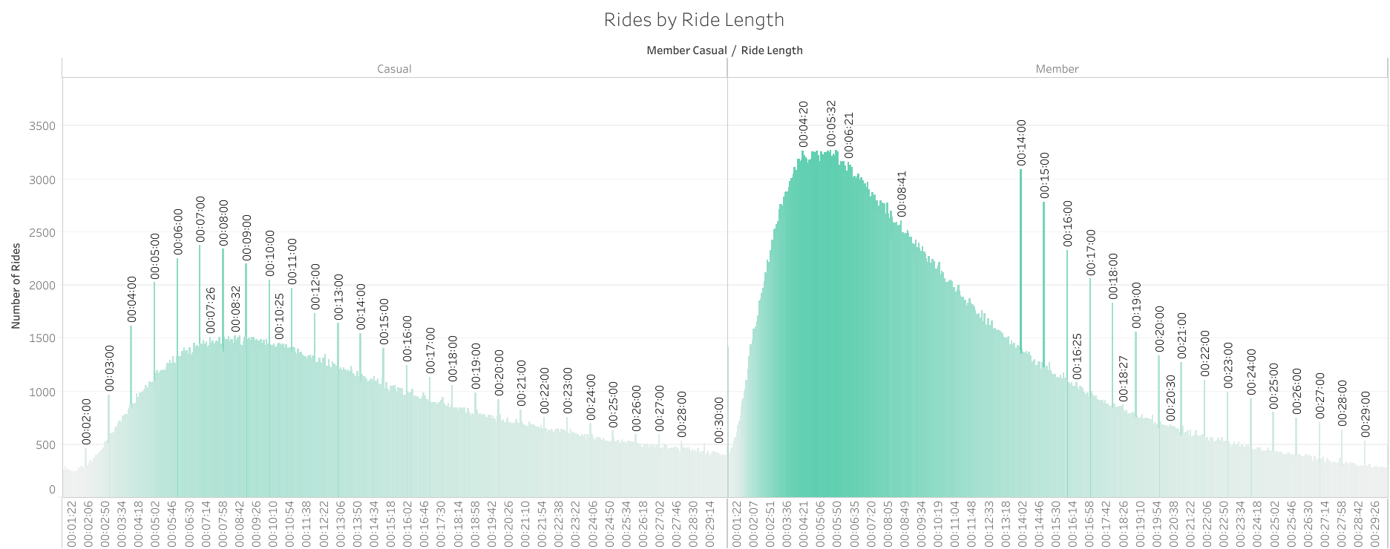
Casual riders are riding for longer periods of time, on average more than double the time of Members.
Mean ride length
Casual Member | 27 minutes 15.8 seconds 12 minutes 51.8 seconds

Slide 6
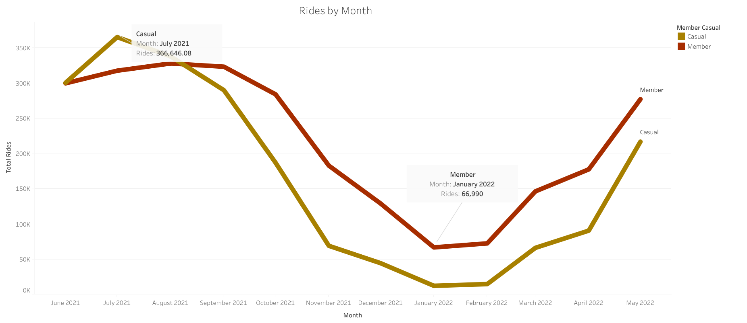
Both Casual and Member riders have significant lows in the Winter Season. Casual Riders have a wider range from Highest use to lowest use.

Slide 7
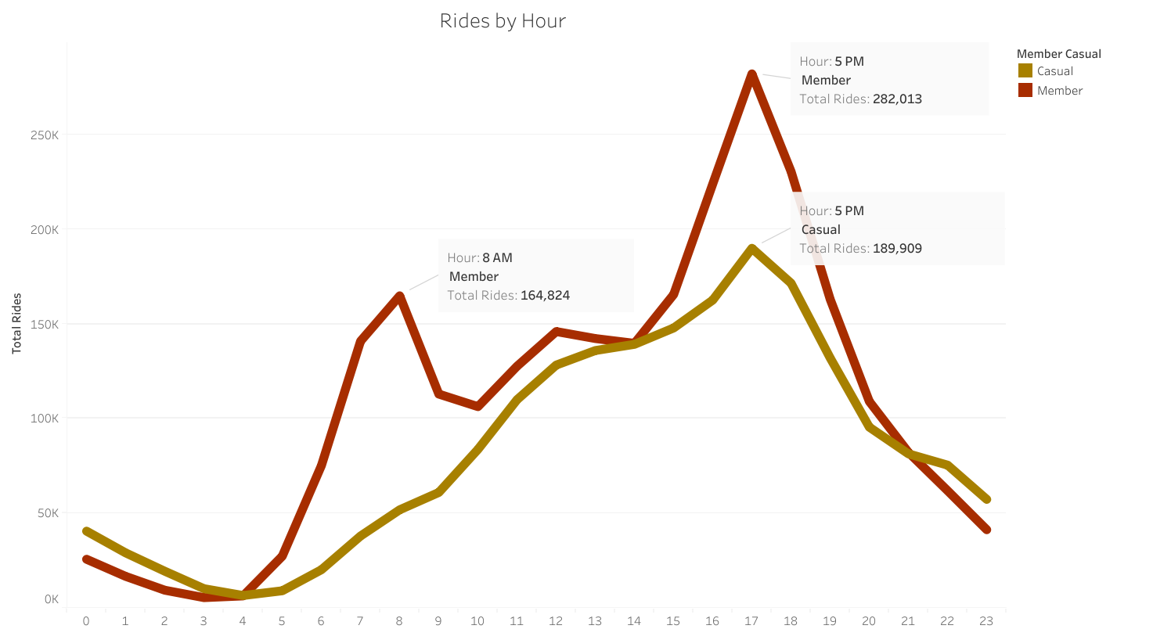
Member Riders have peaks at 8 A.M. and 5 P.M. correlating with work shifts.
Casual Riders have A gradual increase until Peak rides at 5 P.M.

Slide 8
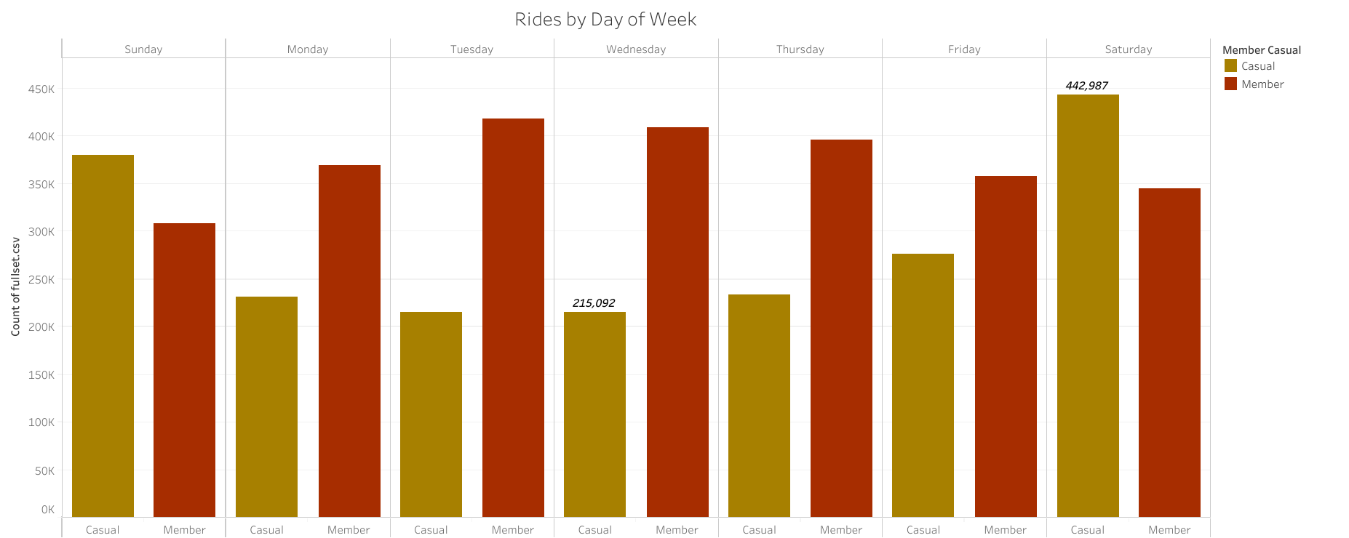
Casual riders have a wide range of riders per day which peak on Weekends Members are steady throughout the Week with slight dips on Weekends

Slide 9
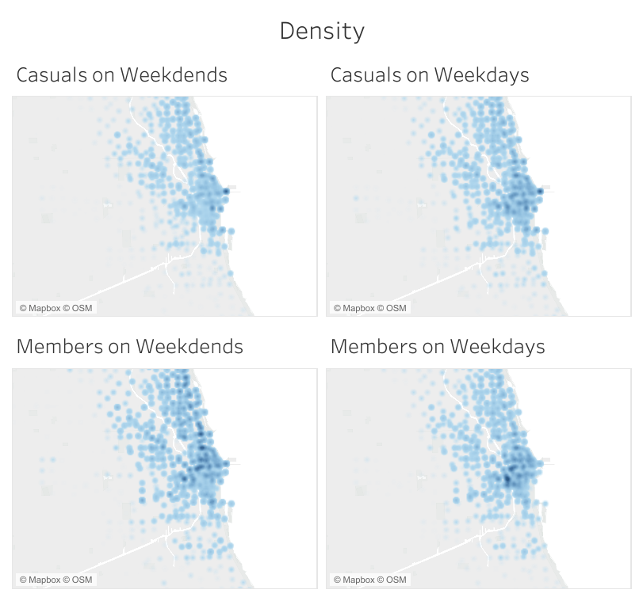
Differences in Density of start stations
Casual: More likely to use bikes near lake Michigan and other tourist hotspots with more rides on weekends indicating people are using the bike for leisure
Members: More likely to use in the downtown area and on weekdays, indicating these user are commuters to the city for work.

Slide 10
Trends

Slide 11
Trends

Slide 12
Recommendation

Slide 13
Recommendation

Slide 14
Conclusion

